Slide 1
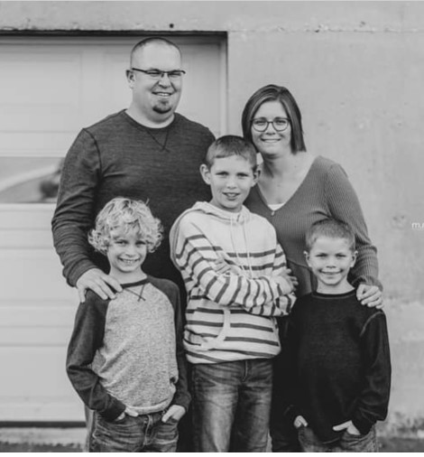
Mrs. Heitkamp – English Language Arts
This is my 15th year teaching in Greenville. I live in New Bremen, Ohio with my husband and 3 sons. I am excited to be working with your child to help them develop a love of reading.
High School: Marion Local
Bachelor’s Degree: Wright State University
Master’s Degree: Wright State University
Phone: 937-548-2815 ext.3227
Email: jheitkamp@gcswave.com
Taking walks, spending time with my family, riding bikes, sports and reading.

